Slide 1


Slide 2
Team members, Mentors
Team members
Ankur Mehta
Jairaj Shetty
Niranjanprasad Bhagwat
Shwetank Nagar
Vikas Phatak
Fafadia Technologies – Siddharth Shah
Faculty mentor – Gunnvant Singh

Slide 3
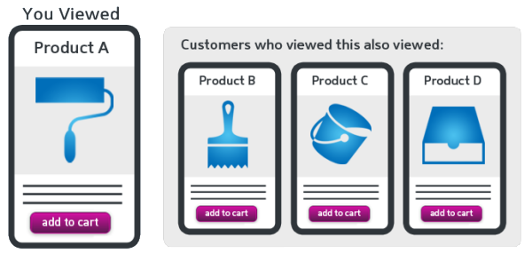
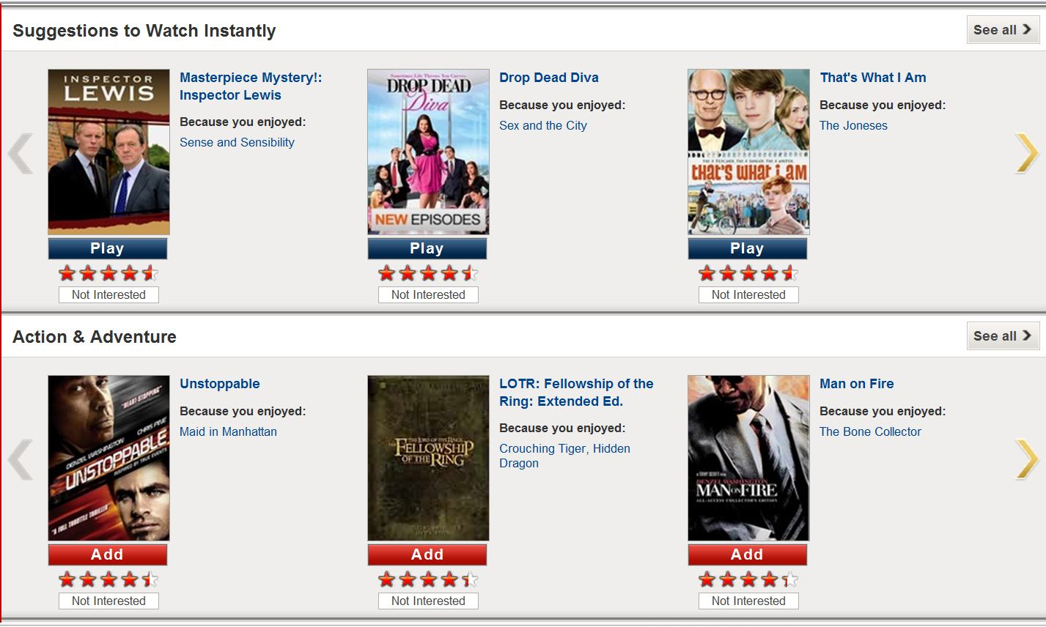
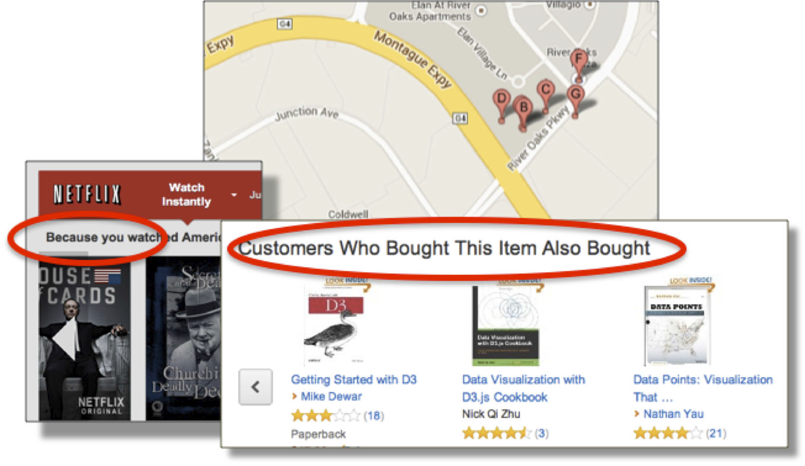
Recommendation… sounds familiar

Slide 4
Recommendation Engine

Slide 5
Executive Summary
Mention the problem that we are trying to solve
How does it work in real world
High level view of the solution

Slide 6
Business case: News Recommendation
News services are constantly looking for ways to increase readership, and in turn improved contribution margin
One way to improve readership is to recommend news articles specific to a user’s tastes or preferences
Improved readership can be used to generate higher per unit rates for advertising

Slide 7
Scope of Project
Web Crawler
Data Cleaning
Content based engine
Collaborative based engine
Output Evaluation

Slide 8
Use case & stakeholders
Customer - Startup
E-commerce startup offers service to curate articles per user preferences
Analytics Service Provider
Offers service to build a news recommendation engine
Uses data science to improve selection of relevant news articles, e.g. with different models
Generates revenue through advertisements
Beats the competition by increased readership
Helps improve readership with more relevant selections
Notes:
Narrative – how the ecosystem works – interdependence – how the analytics provider helps the customer

Slide 9
Project Problem Statement
The project aims to build
A news recommendation engine
Evaluate different techniques – content based and collaborative filtering
Identify how data science can be used to improve the effectiveness of the recommendation engine

Slide 10
Understanding DATA & Quick Insights

Slide 11
Data Description
Total 2.50 Lakh Articles
Time period: Jul-Aug 2016
Different HTML formats with specific tags for each website
Authors – 15,004; top author wrote 2713 articles, top 10 average is 1844, highly right skewed

Slide 12
Data Exploration and Outcomes

Slide 13
High Level Approach

Slide 14
High level approach - SIPOC
Sources
Users
News source websites
Input
User profile
User ratings (explicit)
Process
Front end capture – user creation, user profile, ratings, click stream
Output
Reco engine
Top match articles
Customer
New Users
Nearest users
User web clicks (implicit)
Articles
Back end – web crawling, data cleanup,
Algorithm development – content + collaborative
Performance evaluation & iterative model improvement

Slide 15
User creation and profile buildup
New user registration
Demographic data capture
User creation
Display sub-categories to user
User selection of 3-5 preferred sub-categories
Save user preferences

Slide 16
User ratings’ capture
Explicit Rating
Provide Initial articles, using demographic and sub-category prefs
User rates articles on 1-5 scale (5=best)
Capture user rating
Implicit Rating
Define criteria for clickstream data
Capture user browsing pattern
Define implicit user-article rating

Slide 17
Web crawling
Prepare a list of news site URLs
For each URL, get relevant HTML tags
Capture article using tag (Beautiful Soup)
Save article text
Save source URL, time stamp, sub-categories, keywords etc

Slide 18
Data cleaning
Import data
Escaping html characters
Decoding data
Apostrophe lookup
Removal of punctuation
Removal of expressions
Split attached words
Add cleaned text data to dictionary
Store dictionary

Slide 19
Analytical Process – Tools and Techniques

Slide 20
Content based algorithm

Slide 21
Collaborative filtering algorithm

Slide 22
Model Evaluation Approach
Ensemble approach
Apply all 3 algorithms on entire dataset
Chaining and combination approach
Feed entire dataset to the 1st algorithm; then feed output of 1 to 2nd algorithm, and output of 2 to 3
Take the intersection of all 3 algorithm outputs – URLs and opening lines
Evaluate accuracy of output - precision
Repeat above approach across all model combinations
Evaluate accuracy of all combinations - precision

Slide 23
Performance Evaluation methodology
Confusion Matrix |  | Reality
Model Decision |  | + | -
 | + | True Pos | False Pos
 | - | False Neg | True Neg
Precision – how precise is our recommendation
Formula – TP / (TP + FP)
Where TP is True Positive
# of good articles recommended
FP is False Positive
# of poor articles recommended
Recall – how well have we covered the universe of good articles
Formula – TP / (TP + FN)
Where TP is True Positive
# of good articles recommended
FN is False Negatives
# of good articles missed (not recommended
Tradeoff – reducing False Positives results in an increase in False Negatives
Cutoff decision – if user prefers fewer articles, algorithm with better precision should be selected
If user prefers capturing all articles, algorithm with better recall to be picked
Ideally the engine should be tailored to user preferences

Slide 24
Conclusion

Slide 25
Appendix

Slide 26
References

Slide 27
Questions?

